Slide 1

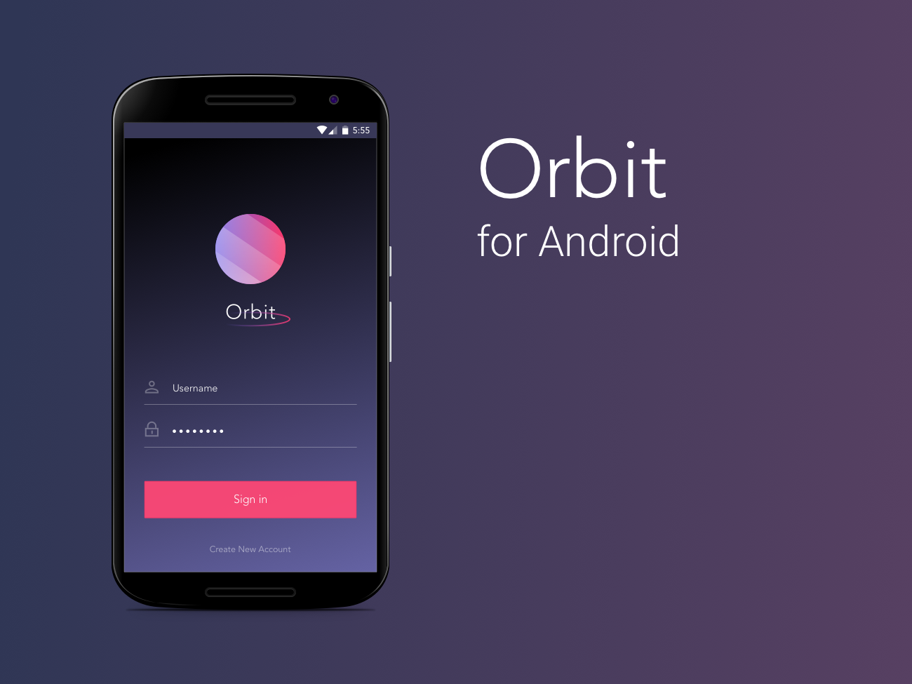
Orbit
WALKTHROUGH
Walkthrough
***screens from design, may differ slightly from current build***
Richard, Carol & Percy

Slide 2
INSTALLATION & REQUIREMENTS

Slide 3
Requirements
Internet connection
An Android phone device
User account (feel free to also create a new account if you want):
Username: testuser
Password: password

Slide 4
Installation Instructions
From Phone (easier):
Go to settings, scroll down to security and select checkbox “unknown sources”
Download the Android Package File (APK)
Go to app drawer and click downloads
Open the file and install the app
From Computer (more difficult):
Connect android device to PC and enable USB mass-storage mode
Drag and drop file onto device
Use file manager (such as Astro or ES File Explorer), locate the file on the device and install it

Slide 5
USER FLOWS, WALKTHROUGH
(It should be mostly self explanatory - some of the screenshots might look a little different from current build)

Slide 6
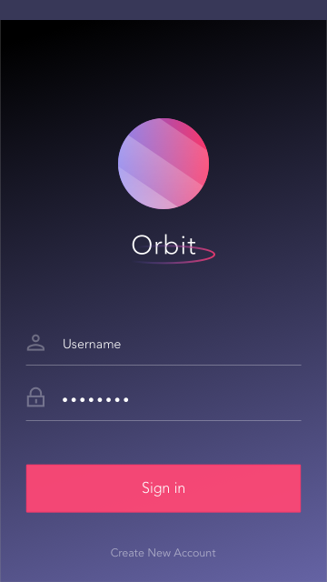
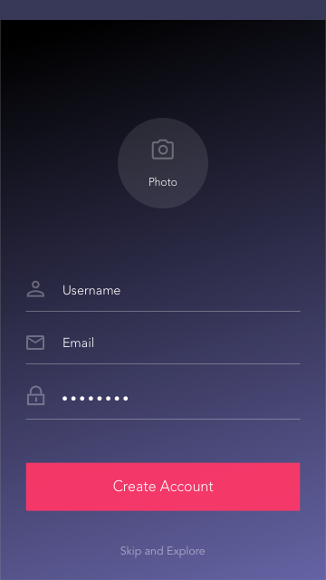
Login Sign-Up Screen
Login Screen
enter username & password and press “sign in”
Create Account
create a new account prompts user to enter a username, e-mail, and password
user can upload a photo for their profile here (optional)
C
B
A

Slide 7
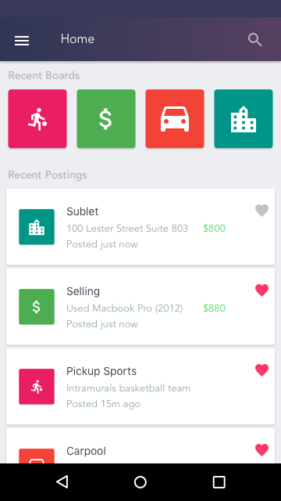
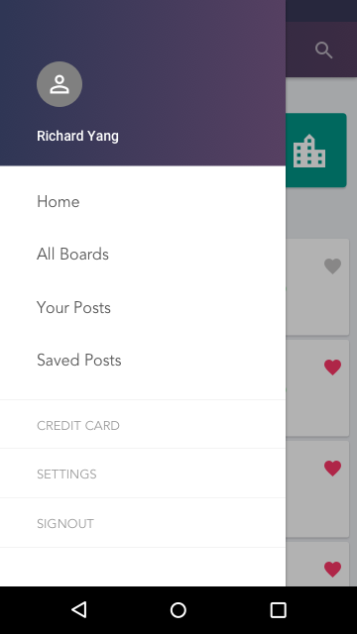
Home Screen & Navigation
E
Home Screen
View recently accessed boards (this will come in handy when we introduce more)
View the recent postings across all boards (kind of like a news feed of student postings)
Select individual postings to view them in more detail
Select a board to view all postings inside it
Navigation Drawer
Accessible by selecting the hamburger menu on the navigation bar
A
D
B
C

Slide 8
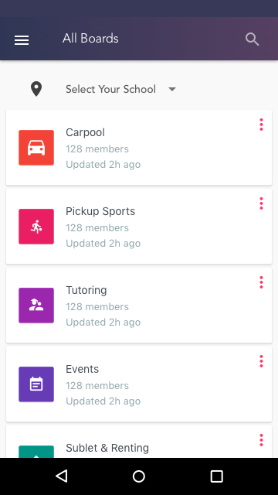
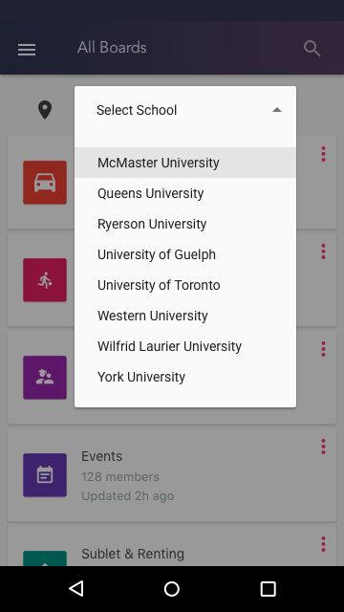
Select School (Filter) & View Boards
Select School:
User can filter boards and postings by school (optional)
View All Boards
User can view all boards, selecting a board opens up all the postings in that board (filtered by school if desired)
Each board includes “time since last update” and “total members” data (out of scope for now - negative impact during initial launch)
A
B

Slide 9
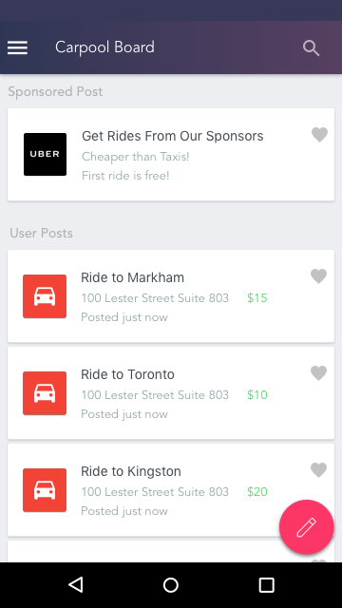
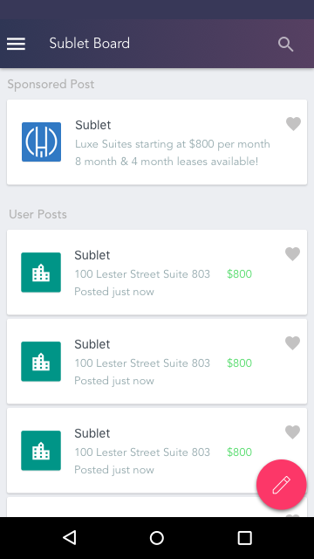
View Postings in Board
Save Posts
Users can save posts by tapping the heart button on each post (out of scope)
Ad Space
Ads are interacted with the same way as user postings
View Post
Users tap a posting to view more details
B
A
C

Slide 10
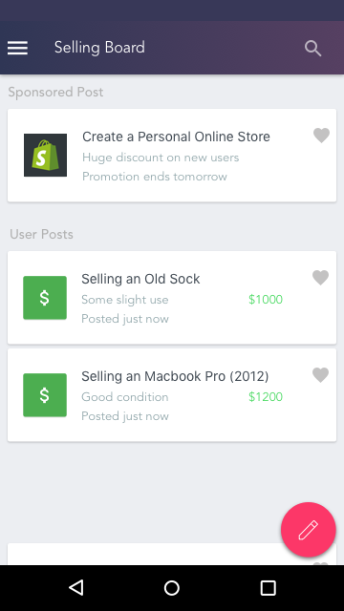
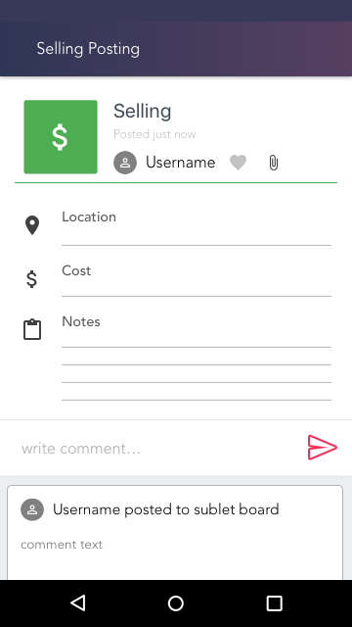
View Posting (Specific)
View user profile by selecting username or avatar
Save postings by selecting heart icon
View attached images by selecting the paperclip icon (out of scope)
Write comments directly in the posting
View data on when it was posted, location, cost, notes, etc.
Custom fields for each type of posting i.e. pickup sports will have a “sports” field, buying & selling with have a “condition” field, etc. (out of scope)
A
B
C
E
D

Slide 11
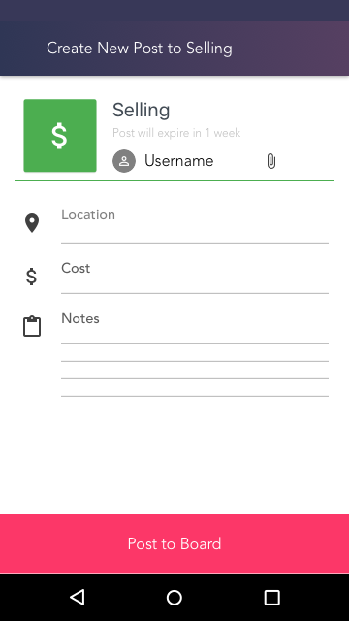
Create New Post
User can create a new posting in the current board (5 postings max per board)
The post will automatically populate your username and timestamp
Enter information in the posting fields (location, cost, notes)
Custom dropdown menus & pickers for each field (out of scope)
Select paperclip icon to attach images from camera roll or take picture directly inside the app (out of scope)
E
C
B
A

Slide 12
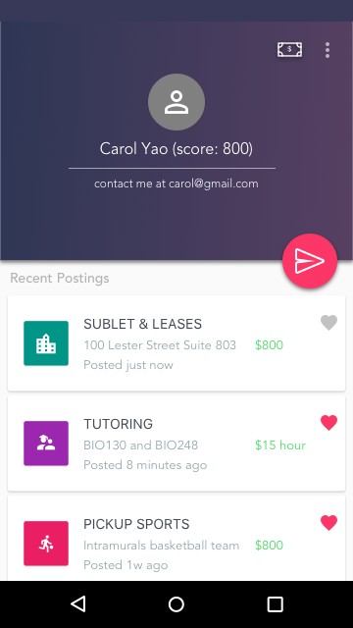
View Other User Profiles
View recent their recent posts
Save their posts directly
Send them a private message
View their contact details
View their score (out of scope - part of gamification & rewards program)
Pay them directly inside the app using credit card (out of scope)
F
E
D
A
C
B

Slide 13
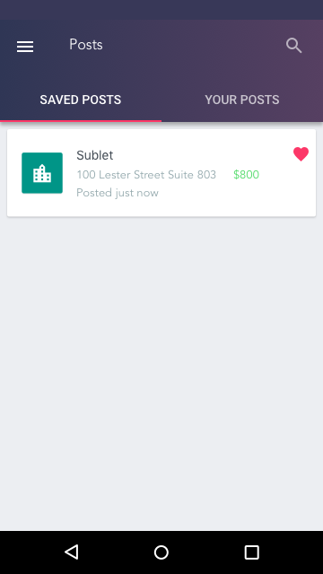
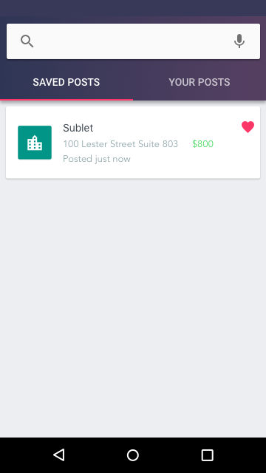
View Saved Posts
View saved posts and postings you’ve posted
Searchable (out of scope)
B
A

Slide 14
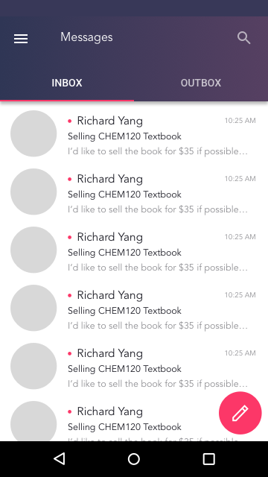
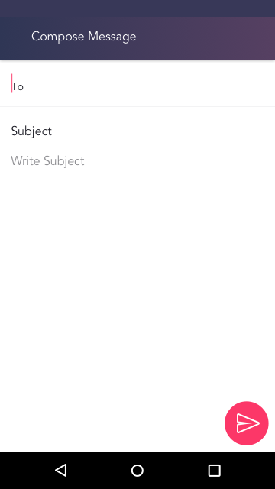
Messages (Inboxes & Outboxes)
View Messages in inbox (received) and outbox (sent)
Unmarked messages marked with pink dot
Messages include header, body text, timestamp, and sender username and profile picture
Compose new message & send by selecting the floating action button
A
D

